Slide 1

PREDICTION OF
ELECTRIC CAR SALES IN NORWAY
Under Guidance of Professor Indranil Bardhan
Group No:9
Apurva Sinha
Prathyusha Alay
Surajkumar P. Malpani
Sushmitha Abboju
Vamsee Krishna Guduguntla

Slide 2

CONTENTS
INTRODUCTION
OBJECTIVE
HISTORICAL INSIGHTS
PRE-PROCESSING OF DATA
METHODOLOGY
TOTAL CAR SALES FORECAST
CO2 EMISSION FORECAST
ELECTRIC CAR SALES FORECAST
PREDICTION OF TOP 5 MANUFACTURERS
CONCLUSION
REFERENCES

Slide 3
INTRODUCTION
ELECTRIC CARS IN NORWAY
Electric - Powered cars are in high demand these days. EVs today are available in virtually every size and style, from compact two-seaters to seven-passenger SUVs.
Norway is noticed to be one of the top countries having reported all-time-high sales of electric cars.
Modern EVs can travel between 100 and 400 miles on a single charge, depending on type and driving conditions
Norway is planning to be ready for 100% Electric Cars by 2025 as per the rule set by their government to have cars with zero CO2 emissions.
Improved battery technology, faster charging, greater range, lower costs & to reduce the greenhouse gas emissions.
Sales of electric and hybrid cars rose above half of new registrations in Norway in 2017

Slide 4

OBJECTIVE
Forecasting Car Sales for 2018 year of total Cars (Diesel/Hybrid/Electric)
01
Total Car sales (Diesel/Electric/Hybrid) from 2007-2017
Influence of electric cars in mitigating pollution & predicting average CO2 emission
02
Prediction of zero CO2 emissions year
Prediction of Top Car Manufacturers in Norway
03

Slide 5
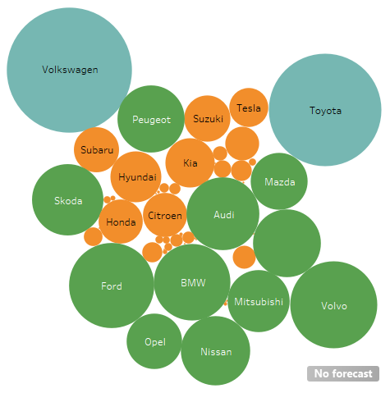
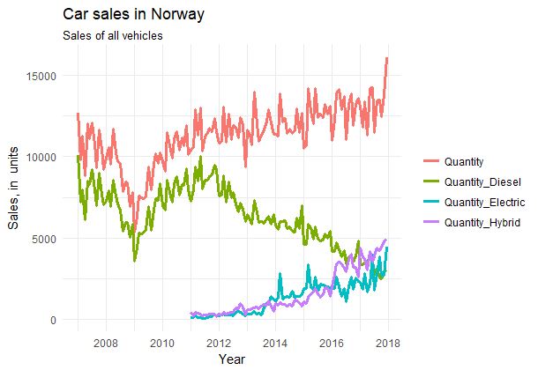
HISTORICAL INSIGHTS
Quantity of Cars Manufactured
by different makes
Time Series plot of quantity of cars

Slide 6
DATA PRE-PROCESSING
Dataset has been converted into time series & ensured that there are no missing values & outliers
Employed logarithmic transformation to make the data stationary
Jan’07
Dec’15
Jan’16
Jan’18
1
Training Data
2
Test Data
80% training data
20% test data

Slide 7
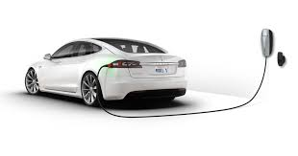
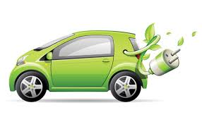

METHODOLOGY
Forecasting has been done in 3 nos. of different models and the most accurate model is used for better prediction namely:
ARIMA Model : Auto-Regressive Integrated Moving Average (p, d, q)
Holt Winters Model : Determines unknown parameters & reduces squared prediction error
ETS Model : Exponential Smoothing (Considers trend & seasonality with smoothing method way i.e. additive, damped or multiplicative)

Slide 8
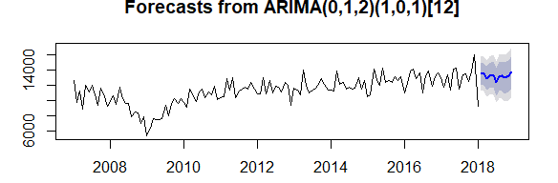
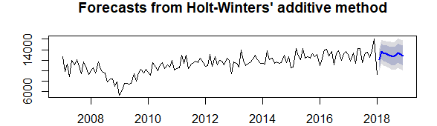
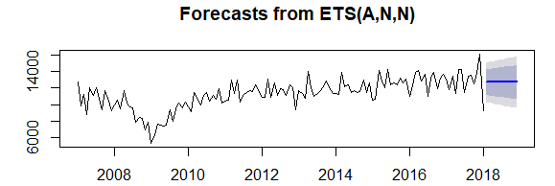
FORECAST OF TOTAL CAR SALES FOR 2018 YEAR
ARIMA
HW
ETS

Slide 9
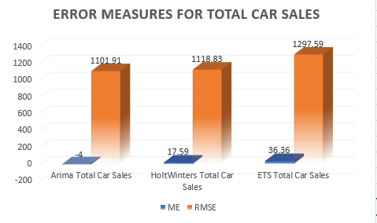
MEASURES FOR TOTAL CAR SALES
The ME/RMSE value for ARIMA model is the least among all the other models.
AIC/BIC VALUES

Slide 10
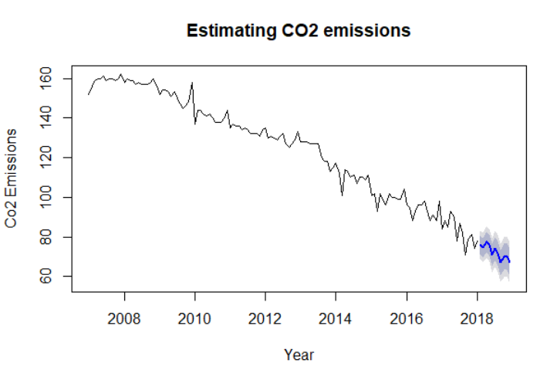
FORECAST FOR PREDICTING ZERO CO2 EMISSIONS YEAR
ARIMA
The CO2 emission trends to decrease and be approximately zero by 2023 under 95% confidence Interval.

Slide 11
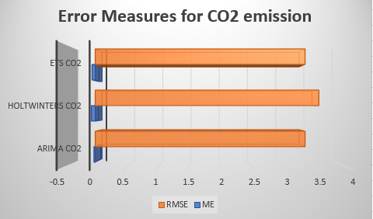
MEASURES OF ZERO CO2 EMISSION YEAR
ERROR MEASURES
AIC/BIC VALUES

Slide 12
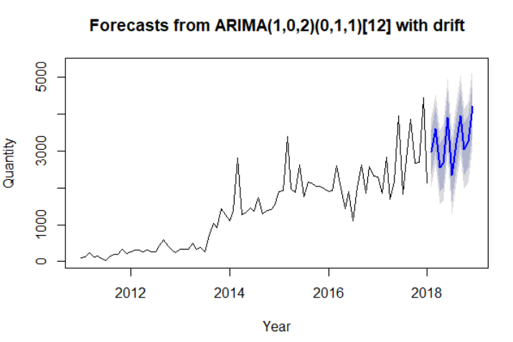
PREDICTING ELECTRIC CAR SALES
ARIMA
The Electric car Sales trends to increase in 2018 under 95% confidence interval.

Slide 13
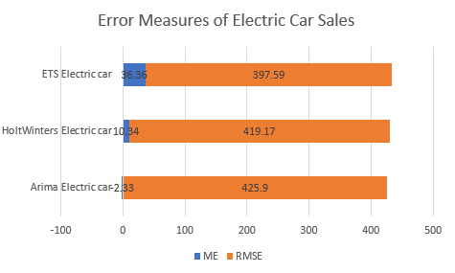
MEASURES OF ELECTRIC CAR SALES
ERROR MEASURES
AIC/BIC VALUES

Slide 14
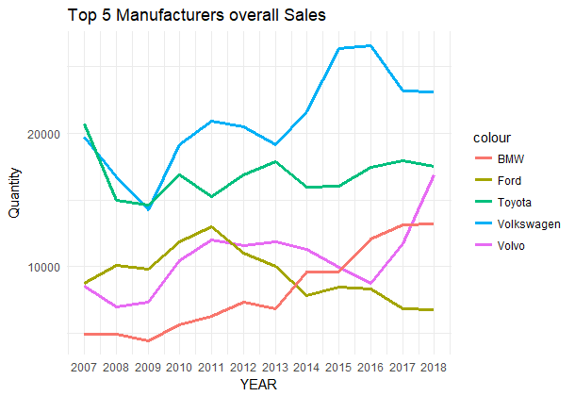
PREDICTION OF TOP 5 MANUFACTURERS
Volkswagen will be the top manufacturer for the year 2018.

Slide 15
CONCLUSION
1
Electric Cars
Total number of Electric cars which shall be sold in 2018 are 38902
Electric Cars
2
Total Cars
Total number of cars which shall be sold in 2018 are 154189. OFVs Forecast is 157700
Total Cars
3
Zero CO2 emission year
CO2 Emissions
Year of zero CO2 emission for Norway is predicted to be 2023 with 95% confidence interval.
Top Manufacturer
STEP4
4
Top Manufacturer
The top manufacturer of Electric Car in 2018 is predicted to be Volkswagen among top 5 manufacturers

Slide 16
REFERENCES
KAGGLE Source:
https://www.kaggle.com/dmi3kno/newcarsalesnorway
OFV Source:
http://www.ofvas.no/
https://www.reuters.com/article/us-environment-norway-autos/norway-powers-
ahead-over-half-new-car-sales-now-electric-or-hybrid-idUSKBN1ES0WC
https://www.edmunds.com/electric-car/

